Slide 1

,
Quantum Ducks
By:
Max Al-Hasso, Ben Kuchma, Tadiwanashe Mavetera, Utkal Pandurangi, Mohammad Habibeh
IonQ’s Challenge

Slide 2
Some quantum concepts….
IonQ’s Challenge

Slide 3
Wave-Particle duality:
Quantum interference and superposition
IonQ’s Challenge

Slide 4
Quantum Entanglement
quantamagazine.org
IonQ’s Challenge

Slide 5
Quantum Teleportation
IonQ’s Challenge
minutephysics//YouTube

Slide 6
X-gate
The Pauli-X gate is a single-qubit rotation through π radians around the x-axis.
IonQ’s Challenge
lewisla.gitbook.io

Slide 7
Our story’s characters…

Slide 8
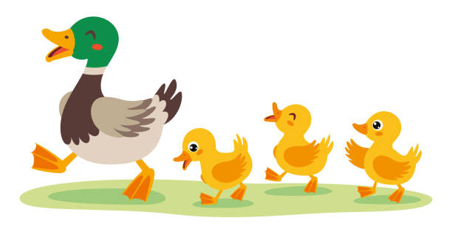
Characters:
Mama and her ducklings

Slide 9
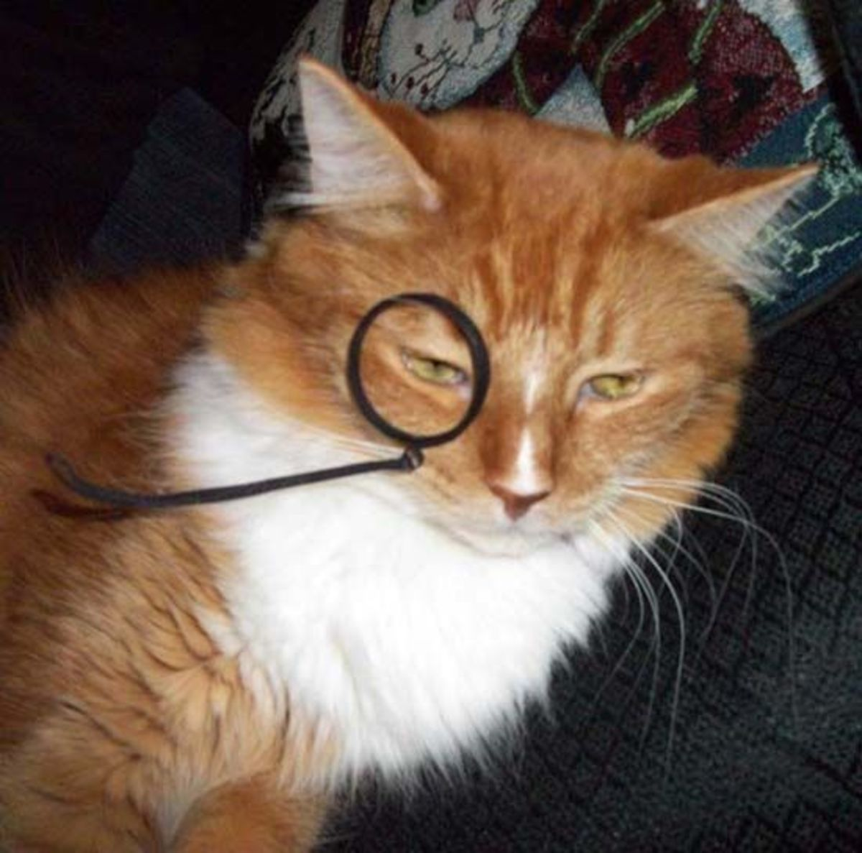
Character: Cat
The quantum purrrpetrator.

Slide 10
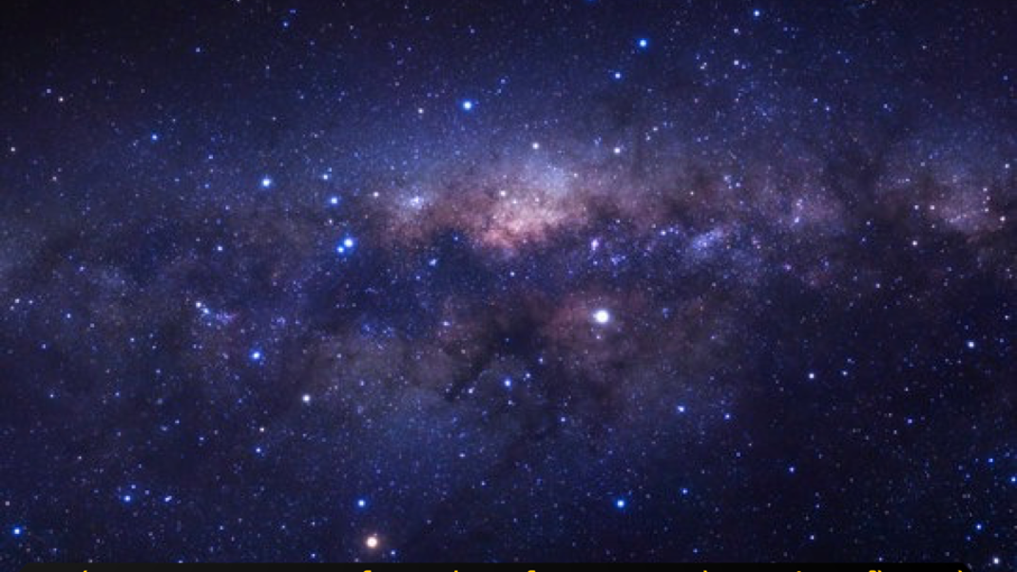
In the vast expanse of a galaxy far away, where time flowed differently from our own, there existed a universe filled with wonders and mysteries. In this extraordinary realm, a mama duck tended to her nest of four beautiful eggs. Little did she know that the tranquility of her cosmic pond was about to be disrupted by the actions of a reckless cat criminal, the Quantum Purrpetrator

Slide 11
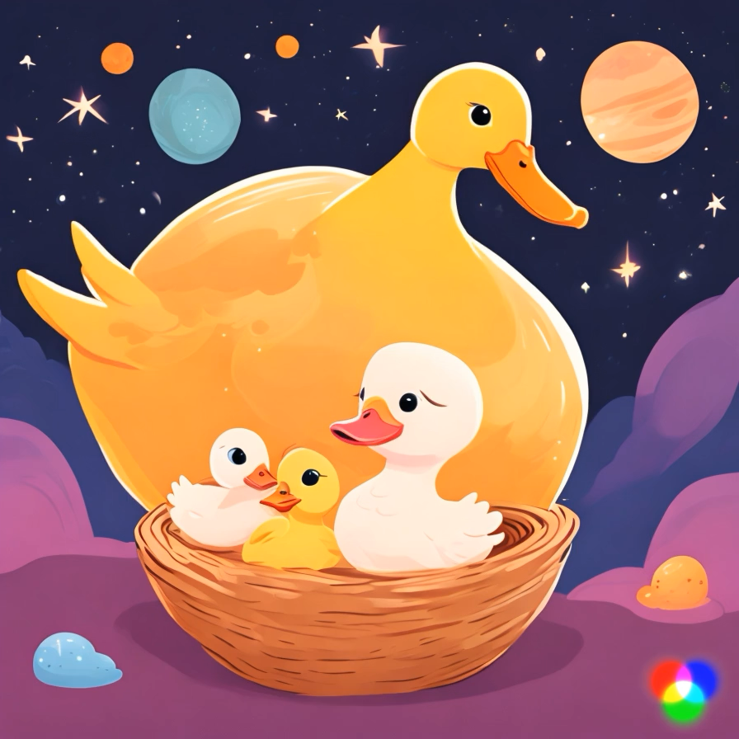

Slide 12
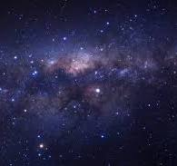
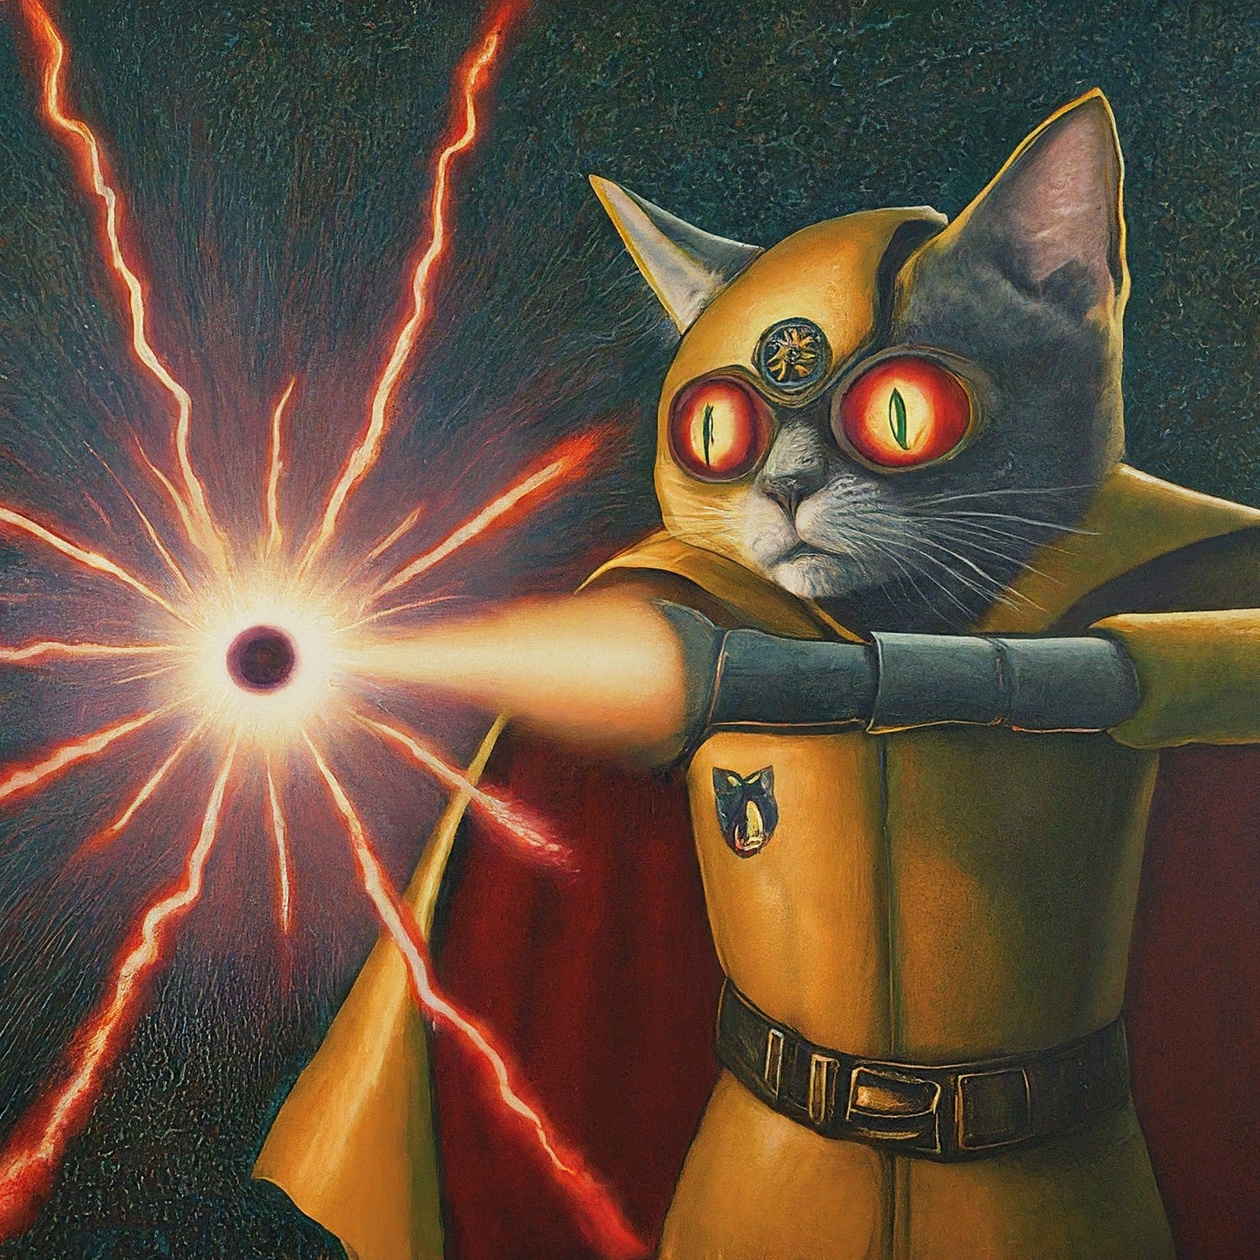
THE CAT PURRPETRATORR
(SCHRÖDINGER CAT)
This feline miscreant, armed with a nefarious quantum disruptor, set his sights on the unsuspecting mama duck. With a malevolent cackle, he unleashed the disruptive force, causing the mama duck to undergo a peculiar transformation. She now exhibited quantum states at the macroscale - a stunning blue in ket 0, a fiery red in ket 1, and a mesmerizing purple while existing in a superposition state

Slide 13
WHAT HAPPENED TO MAMA DUCK AND THEN DUCKLINGS
In the aftermath of the quantum disruption, Mama Duck found herself in a perplexing state, oscillating between quantum colors with each passing moment. Her once serene cosmic pond became a living kaleidoscope, reflecting the quantum turmoil that had befallen her. Devastatingly, the mama duck's newfound quantum nature rendered her unable to rec her own ducklings unless they, too, assumed a matching quantum state.

Slide 14
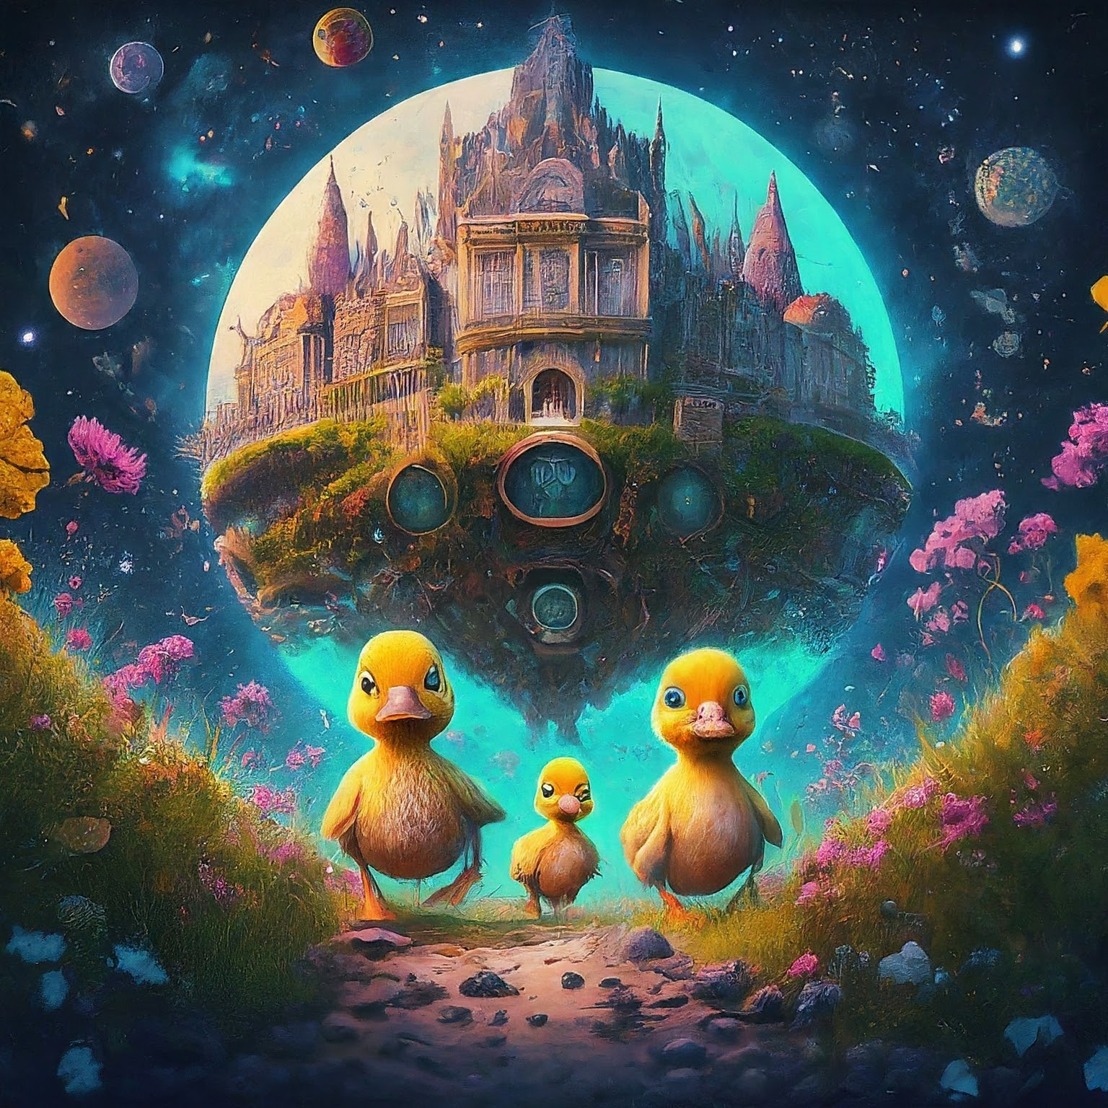
The ducklings embark on a journey to master QC at the iQuHack University
Undeterred by the challenge, the ducklings, now separated from their loving mother, decided to embark on a quest for knowledge at the iQuHack University – the most prestigious institution in the entire galaxy, specializing in quantum mechanics and quantum computing.
Under the tutelage of renowned quantum professors and with determination burning in their hearts, the ducklings delved into the intricacies of quantum physics.

Slide 15
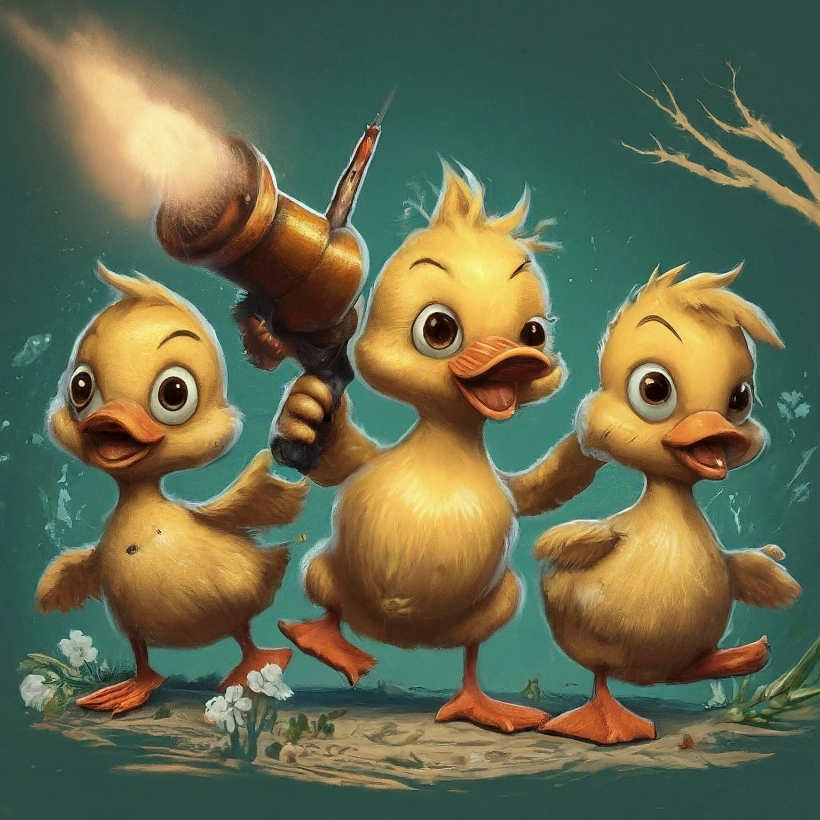
They get the gun and steal it
Armed with their newfound knowledge, the ducklings hatched a daring plan to retrieve the quantum disruptor from the clutches of the cat criminal. Sneaking into the criminal's lair, they skillfully stole the device, which had caused their family so much distress.
Utilizing the properties of the quantum disruptor, the ducklings enabled quantum states on themselves. They now shimmered in various colors, mirroring the quantum spectrum just like their mama. Yet, they weren't done; drawing upon their mastery of quantum computing, they manipulated their own quantum states to synchronize with that of their beloved mama duck.

Slide 16
With their knowledge they embark to reunite with their mother
Armed with their newfound knowledge, the ducklings hatched a daring plan to retrieve the quantum disruptor from the clutches of the cat criminal. Sneaking into the criminal's lair, they skillfully stole the device, which had caused their family so much distress.
Utilizing the properties of the quantum disruptor, the ducklings enabled quantum states on themselves. They now shimmered in various colors, mirroring the quantum spectrum just like their mama. Yet, they weren't done; drawing upon their mastery of quantum computing, they manipulated their own quantum states to synchronize with that of their beloved mama duck. Now resembling their quantum-altered mother, the ducklings embarked on an intergalactic journey to reunite with her. Along the way, they encountered challenges that tested their newfound quantum abilities, but their determination and the bonds of family carried them forward.

Slide 17
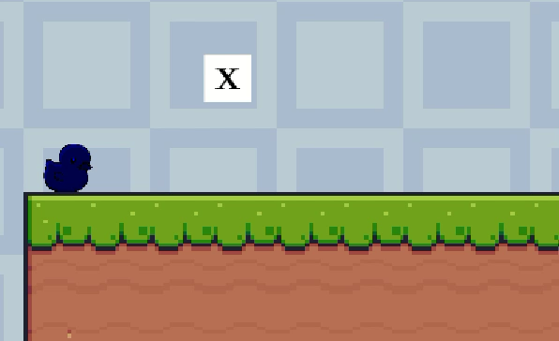

Slide 18
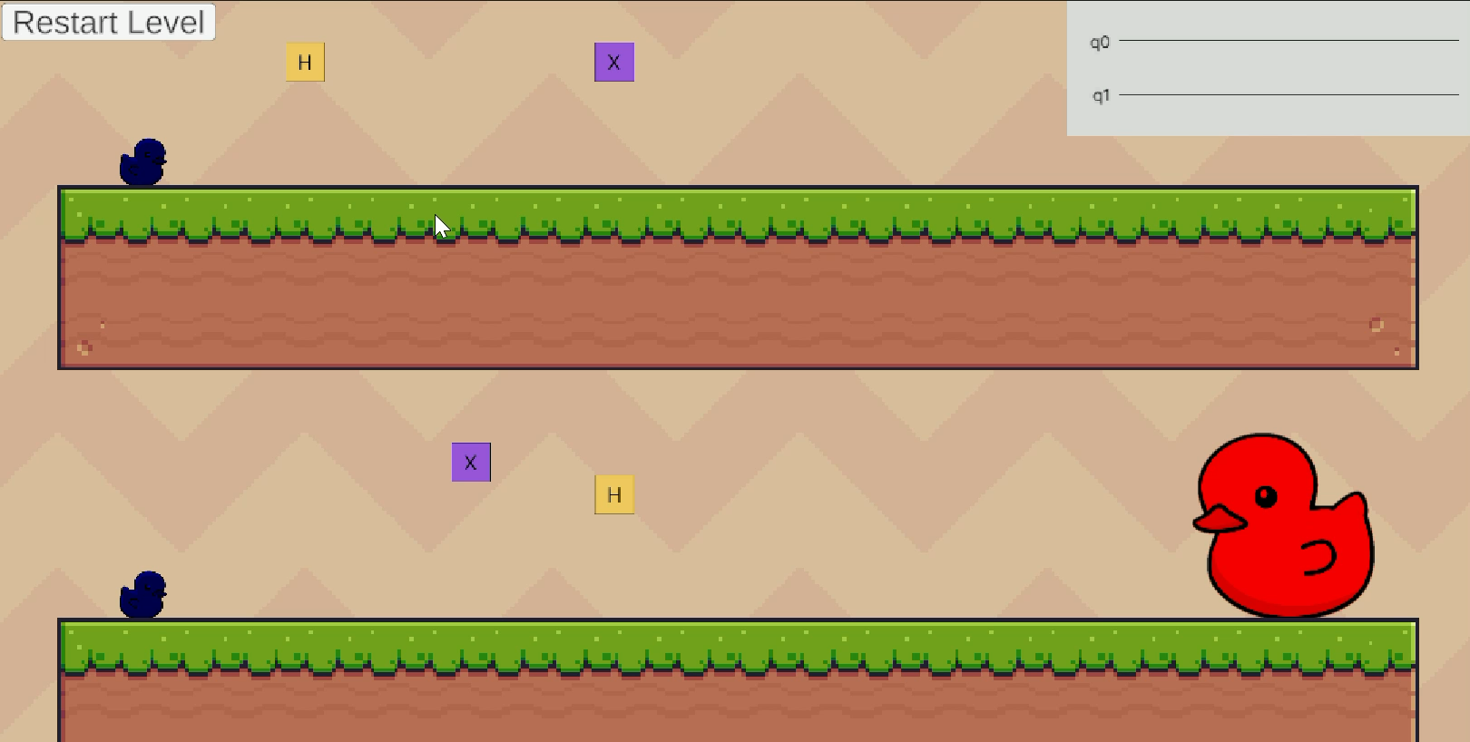

Slide 19
GAME PLAY

Slide 20
Thank You
IonQ’’s Challenge

